Slide 1

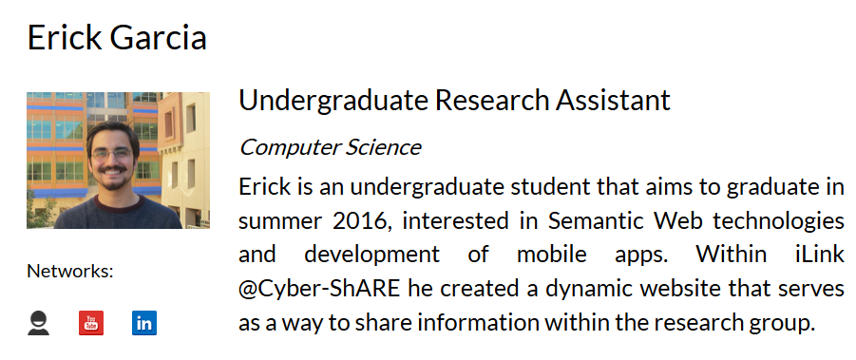
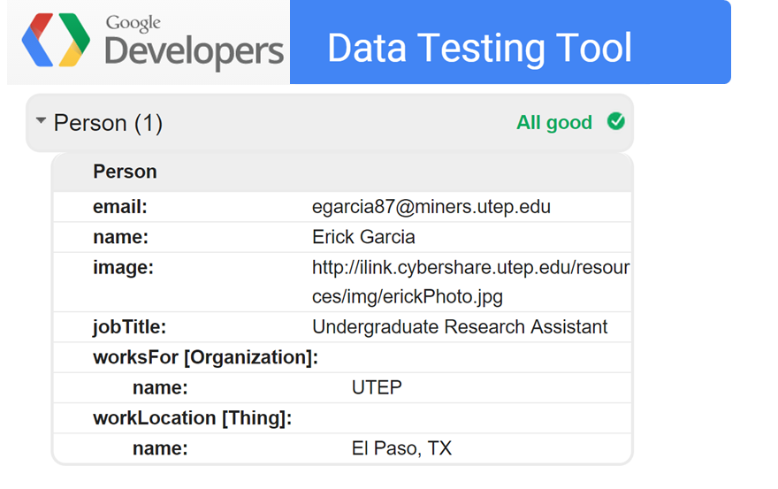
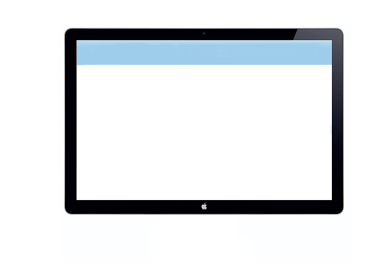


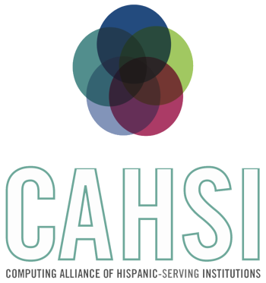


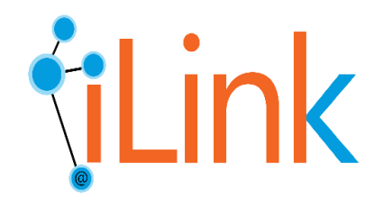
CYBER-ShARE Center of Excellence
Sharing Resources to Advance Research and Education through Cyber-infrastructure
Semantic-based data integration and exchange for a research group
Erick Garcia^{1,2}, Natalia Villanueva-Rosales^{1,2,*}
¹Department of Computer Science, ²Cyber-ShARE Center of Excellence, *Faculty Mentor
egarcia87@miners.utep.edu, nvillanuevarosales@utep.edu
The University of Texas at El Paso
Abstract
Disseminating products resulting from research efforts for validation, reproducibility, and reuse is an important task of a research group. Sharing resources using natural languages, like English, are good for humans but hard for computers to process. Sharing resources using machine languages, like JSON, are great for machines but hard for humans to understand. Having a one-stop place where resources of research groups can be dynamically populated from other sources and share information for both, humans and machines, would save time and also increase reusability of their resources. In this paper, we describe our approach to disseminate the products of the iLink group through a web-based application designed for both humans and machines.
Background
Results
The Semantic Web is a set of standard languages and tools promoted by the World Wide Web Consortium for exposing machine understandable data to be shared and reused. [2]
Web-Services are applications that enable the communication between two electronic devices over a network. [2]
Metadata is structured information that describes, explains, locates, or otherwise makes it easier to retrieve, use, or manage an information resource. It facilitates discovery of relevant information. [1]
The iLink research group’s dynamic website was created. This website is: i) dynamically populated from other sources, ii) based on Model-View-Controller architecture, iii) based on standard web-languages and technologies including Bootstrap, Code Igniter, HTML5 and JSON.
The information shared on the iLink’s website is semantically annotated which means it is fully understandable for both humans and machines. (Fig. 2 & 3)
Research Question
Person
hasJobTitle
Job Title
Can semantic-, web-based approaches, e.g., ontologies, enable the creation of systems that automatically integrate information about a research group and share information for both humans and machines?
hasResearchInterest
hasDegree
hasPersonalWebsite
Objective
Degree
Design a web-based application for the iLink research group that can be :
dynamically populated from heterogeneous sources,
mobile-friendly for human consumption,
use web standards for interoperability of other systems, and
share resources using semantic annotations (meta-data) for machine processing. (Fig. 1)
Personal Website
Research Interests
Methodology
Figure 2. Differences between data that can be understood by humans vs. data that can be understood by machines.
Design of a high-level data model (E/R diagram) that covers information retrieved from other sources and metadata
Evaluation for frameworks for web development that supports the creation of responsive mobile-, human-friendly website and the use of standards for interoperability
Development of a front- and back- end of a research group website through the use latest web-based technologies.
Comparison of metadata standards and vocabulary to share research group’s resources with semantic annotations.
Semantic Annotation of all the information shared through the website.
Evaluation of the web-based system.
<meta>
</meta>
DB
Dynamic
Semantically Annotated
Mobile Friendly
Figure 3. Google’s testing tool was used to verify that metadata in the website can be discovered and indexed by search engines. [5]
Resources
Conclusions
Figure 1. By Integrating the research group’s resources and metadata, a dynamic semantic annotated website can be generated.
Evaluation of the system based on:
Discoverability of resources by machines using metadata.
Usability for human users.
The ability of search engines understanding the websites data so there will be more accurate results to what the user is searching.
The semantic annotation was done in RDFa instead of Microformats, or Microdata has the advantage of being able to create your own vocabulary if it does not already exist.
References
[1] Understanding Metadata (pp. 4-10). (2004). Bethesda, NISO Press National Information Standards Organization
[2] Semantic Web, Retrieved April 15, 2015 from http://www.w3.org/standards/semanticweb/data
[3] FOAF, Retrieved April 15, 2015 from http://www.foaf-project.org/.
[4] iLink Website: http://iLink.cybershare.utep.edu/
[5] Structured Data Testing Tool, Google, Retrieved April 15, 2015 from https://developers.google.com/structured-data/testing-tool/
This work used resources from the Cyber-ShARE Center of Excellence and the Computing Alliance of Hispanic Serving Institutions (CAHSI), which are supported by National Science Foundation, grant numbers HRD-0734825 and CNS-1042341 respectively. Special thanks to the iLink research group members for their support in this work.
Linking knowledge across disciplines,
data and models
Cyber-ShARE

